Slide 1

A regression-based modelling approach for accurate dynamic power estimation in digital circuits
16/01/2023
Monticelli, D. – Student ID: 1610228
Electrical engineering – Electronic systems group
Notes:
Welcome everybody, thank you for joining both here in this room and remotely.

Slide 2
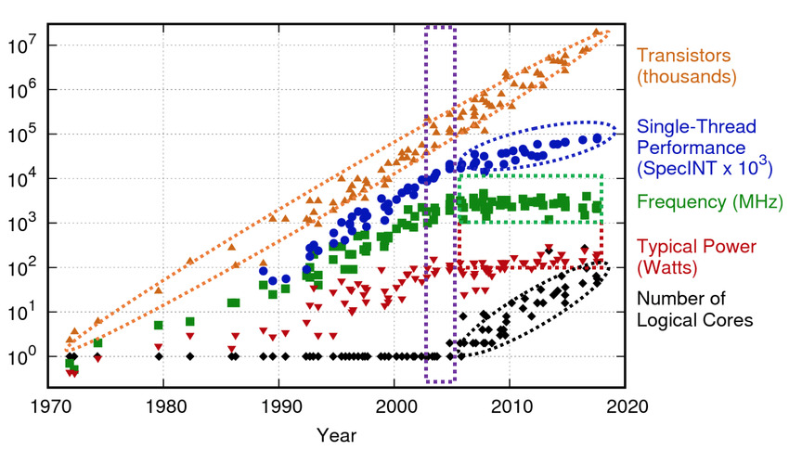
Introduction (1)
As Moore’s law (1965) drives technology scaling…
… The mo(o)re transistors per unit of area
Result: unbearable power density rise in a small chip area
Major design constraint:
power dissipation
…from where power dissipation originates?
Notes:
-The semiconductor…
-Moore’s law depicts a trend for transistor scaling
-Higher speed, higher power

Slide 3
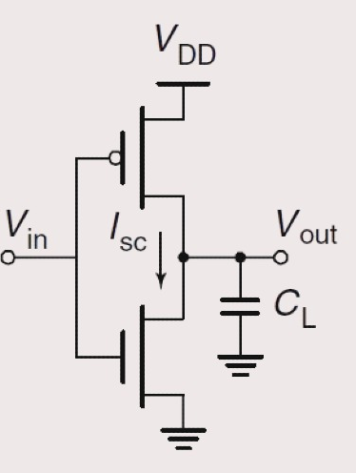









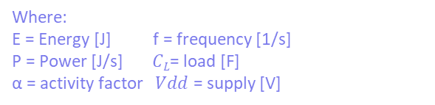
Introduction (2)
Static: Due to parasitic, tech-dependent
Dynamic: charging/discharging capacitive load
$$\frac{1}{2}CL{Vdd}^{2}$$
$$α,C_{L}$$
Energy = $CL{Vdd}^{2}$
P_{dyn} = Energy per transition × switching activity
$$P_{dyn}=C_{L}{Vdd}^{2}×α×f_{ck}$$
$$\frac{1}{2}CL{Vdd}^{2}$$
Where:
E = Energy [J] f = frequency [1/s]
P = Power [J/s] $CL$= load [F]
α = activity factor $Vdd$ = supply [V]
Technology
input stimulus (ie: simulation)
Notes:
-Power can be divided in 2:
-Vdd, f_ck known (we see how P and f_ck are linked)
-CL is given by tech, alpha input stimulus
-Today’s designs have billion transistors, so this solution does not scale well. To deal with this huge variable space, engineers build abstraction layers to reduce it

Slide 4

Introduction (2)
Static: Due to parasitic, tech-dependent
Dynamic: charging/discharging capacitive load
$$\frac{1}{2}CL{Vdd}^{2}$$
Abstractions!
Energy = $CL{Vdd}^{2}$
P_{dyn} = Energy per transition × switching activity
$$P_{dyn}=C_{L}{Vdd}^{2}×α×f_{ck}$$
$$\frac{1}{2}CL{Vdd}^{2}$$
Where:
E = Energy [J] f = frequency [1/s]
P = Power [J/s] $CL$= load [F]
α = activity factor $Vdd$ = supply [V]
Technology
input stimulus (ie: simulation)

Slide 5




Introduction (3)
~minutes
Algorithmic (behavioural)
$$α$$
Need to meet strict power constraints by:
Explore design choices (DSE);
Being accurate
~hours
RTL (structural)
$$C_{L}$$
~days/weeks
Logic synthesis (netlist)
Time (simulation + effort)
~weeks/months
Physical synthesis (placed netlist)
Conflicting trends:
Fast estimations are inaccurate
Accurate estimations take time
~months/years
Sign-off & tape out (on chip measure)
Notes:
-So here we have a simplified version of a design flow
-algorithmic->functionality;
-RTL: functionality but aware of the signals switch
-synthesis: maps the functionality into gates with knowledge on the parasitics
-Timeline is indicative
-Need: evaluate different choices and be accurate
-Conflicting trends

Slide 6
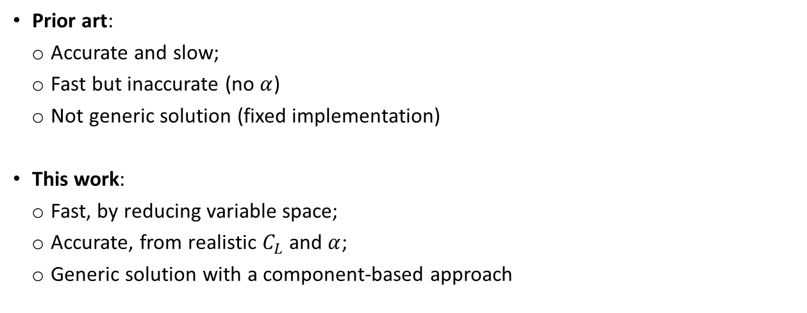
Introduction (4) Problem statement
Prior art:
Accurate and slow;
Fast but inaccurate (no $α$)
Not generic solution (fixed implementation)
This work:
Fast, by reducing variable space;
Accurate, from realistic $C_{L}$and $α$;
Generic solution with a component-based approach
Notes:
-Existing work is either accurate but slow (large design space)
-Or fast and inaccurate , or do not provide a generic solution.
This work tries to overcome such limitation

Slide 7
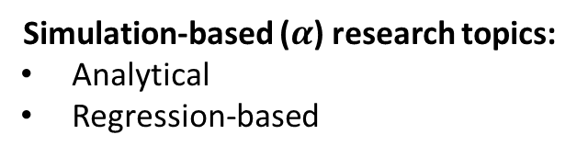
Literature overview (1)
~minutes
Algorithmic (behavioural)
Conventional tools (eg: Joules):
Post-synthesis accuracy
Time consuming for design space explorations
~hours
RTL (structural)
~days/weeks
Logic synthesis (netlist)
Time (simulation + effort)
Simulation-based ($α$) research topics:
Analytical
Regression-based
~weeks/months
Physical synthesis (placed netlist)
~months/years
Sign-off & tape out (on chip measure)
Notes:
What does it mean to be accurate?
-Industry tools at this level would synthesize, simulate and run power for each design flavor, which takes time
-In the research, there are 2 main ways to approximate switching activity factor: analytical and regression-based

Slide 8
Literature overview (2)
Common benefits:
- Hierarchical approach based on OO models
- Fast power estimation
Analytical approach (α from action count)
workload
Common drawbacks:
Action based (no activity involved)
Complex C++ libraries
Performance simulator
Tech parameters (C/C++)
action count
Power model
Estimated power
Notable examples
McPAT for CPUs
DSENT for NoCs
Config. File (user input)
Analytical tool
Notes:
-We feed the tool with libraries that model parasitics and hardware configuration
-then we do not track activity but action counts
-From the technology model and how much a resource is accessed, power is retrieved
-pro/cons

Slide 9
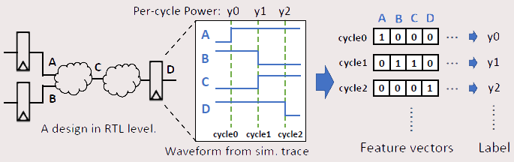
Literature overview (3)
Regression-based (α from proxy activity)
Common benefits:
Accurate results for selected workloads
Fast estimation time
From Apollo paper
Common drawbacks:
Extended cycle-accurate training times
Power model fixed to hardware implementation (preventing DSE)
Examples:
Yukai et al. : L1 regularization for feature selection
Apollo : L1 for selection L2 for relaxation
Notes:
-Regression-based approaches use real activity factors but from few selected signals (proxies)
-To select those signals, simulations are run
-Signals that impact power the most are selected

Slide 10
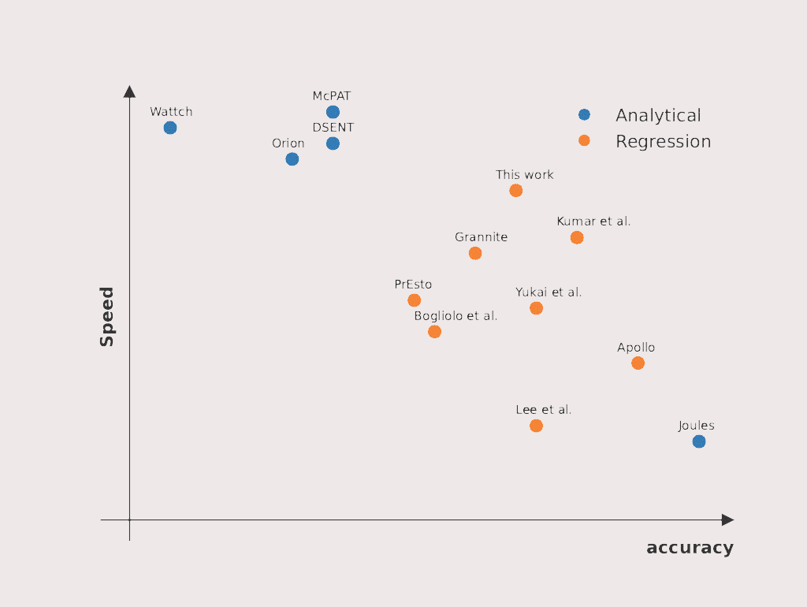
Literature overview (4)
Analytical approach:
Component’s action counts from performance simulator (eg: gem5) associated with power consumption
Pruning approach:
Prune and simulate few proxies representative of the whole design
+Fast
+Hierarchical
-Actions
-Analytical
+accurate
+real data traces
-Long trainings
-Fixed to hardware
Summary of related work
Notes:
-Summary: we organized the work in a speed vs accuracy fashion.
-Analytical populate the top left because…
-Regression-based offer tradeoffs thanks to the various machine learning approaches
-Joules in an outsider

Slide 11
This work (1)
~minutes
Algorithmic (behavioural)
Position of this work
Objective:
approach to quantify early power estimation for power-aware design choices.
This fast
~hours
RTL
(cycle-accurate)
Bridge
the gap
How to achieve this:
Implementation-independent (common) features
Average component’s input/output toggling activity
Regression-based
~weeks
Logic synthesis (netlist)
Time (simulation + effort)
This accurate
~weeks/months
Physical synthesis (placed netlist)
~months/years
Sign-off & tape out (on chip measure)
Notes:
-Overall goal: accurate and fast enough to evaluate different design choices
-To do so: common features, avg in/out,
-We want to abstract the parasitic information and bring them at RTL level

Slide 12
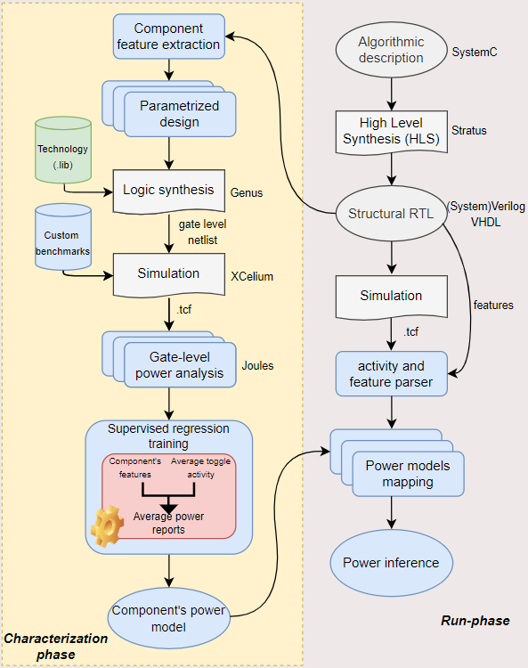
This work (2)
Extraction of generic features
Simulation based on average toggle activity coverage
Supervised training (activity -> power)
Notes:
-Here on the right we can see the methodology flow to build the power model.
-It is divided in 2:
-Taking the structural RTL which is an interconnection of components

Slide 13
This work (2)
Extraction of generic features
Simulation based on average toggle activity coverage
Supervised training (activity -> power)
Notes:
-let’s see how these steps are performed in practice

Slide 14
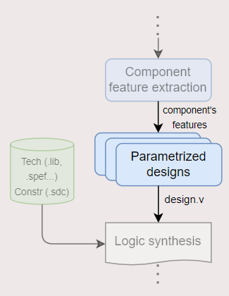
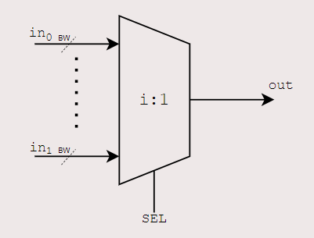
This work (3) Extraction of generic features
N:1 MUX
BW (4÷64) | IN (2÷4)
4 | 2
... | …
64 | 4
One design generated for each parameters combination
In this example: (64-4+1) x 3 = 183 design that will be synthesized
Notes:
-feature extraction consist in finding some component’s parameters that are independent from the implementation
-Taking a simple component such as a mux, those can be…
-After we parametrize the design for each feature configuration, we can synthesize them

Slide 15
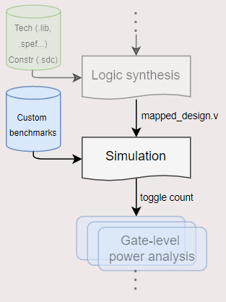
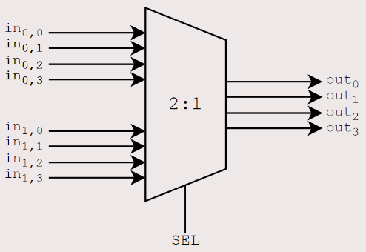
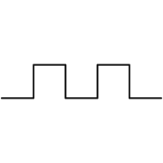

This work (4) Simulation based on average toggle activity coverage
BW (4÷64) | IN (2÷4)
4 | 2
Sweeping input toggle rate: example with BW=4 and toggle_rate=25%
Next
cycle
Clk
0
IN₀
Benchmark generator
0
IN₁
BW = 4
TR = 25%
0
IN₂
0
IN₃
Notes:
-Now for each synthesized design, we want to simulate it to see the power impact of our stimulus.
-To do so, benchmark generator
-it generates input vectors, given the BW and TR (explain TR)
-in this example, it means 1 bit per cycle
-From the animation, we see that on average we are toggling 25% of the bits, and this is done for each configuration

Slide 16
This work (4) Simulation based on average toggle activity coverage
BW (4÷64) | IN (2÷4)
4 | 2
Sweeping input toggle rate: example with BW=4 and toggle_rate=25%
Next
cycle
Clk
1
IN_{0,0}
0
Benchmark generator
0
IN_{0,1}
0
BW = 4
TR = 25%
0
IN_{0,2}
0
0
IN_{0,3}
0

Slide 17
This work (4) Simulation based on average toggle activity coverage
BW (4÷64) | IN (2÷4)
4 | 2
Sweeping input toggle rate: example with BW=4 and toggle_rate=25%
Next
cycle
Clk
1
IN_{0,0}
0
1
Benchmark generator
1
IN_{0,1}
0
0
BW = 4
TR = 25%
0
IN_{0,2}
0
0
0
IN_{0,3}
0
0

Slide 18
This work (4) Simulation based on average toggle activity coverage
BW (4÷64) | IN (2÷4)
4 | 2
Sweeping input toggle rate: example with BW=4 and toggle_rate=25%
Next
cycle
Clk
1
IN_{0,0}
0
1
1
Benchmark generator
1
IN_{0,1}
0
0
1
BW = 4
TR = 25%
0
IN_{0,2}
0
0
0
1
IN_{0,3}
0
0
0

Slide 19
This work (4) Simulation based on average toggle activity coverage
BW (4÷64) | IN (2÷4)
4 | 2
Sweeping input toggle rate: example with BW=4 and toggle_rate=25%
Next
cycle
Clk
0
IN_{0,0}
0
1
1
1
Benchmark generator
1
IN_{0,1}
0
0
1
1
BW = 4
TR = 25%
0
IN_{0,2}
0
0
0
0
1
IN_{0,3}
0
0
0
1

Slide 20
This work (4) Simulation based on average toggle activity coverage
BW (4÷64) | IN (2÷4)
4 | 2
Sweeping input toggle rate: example with BW=4 and toggle_rate=25%
Next
cycle
Clk
0
IN_{0,0}
0
1
1
1
0
Benchmark generator
1
IN_{0,1}
0
0
1
1
1
BW = 4
TR = 25%
1
IN_{0,2}
0
0
0
0
0
1
IN_{0,3}
0
0
0
1
1

Slide 21
This work (4) Simulation based on average toggle activity coverage
BW (4÷64) | IN (2÷4)
4 | 2
Sweeping input toggle rate: example with BW=4 and toggle_rate=25%
Clk
IN_{0,0}
0
1
1
1
0
0
0
0
1
Benchmark generator
IN_{0,1}
0
0
1
1
1
1
1
0
0
BW = 4
TR = 25%
IN_{0,2}
0
0
0
0
0
1
1
1
1
IN_{0,3}
0
0
0
1
1
1
0
0
0

Slide 22
This work (5) Problems
Clk
IN_{0,0}
0
1
1
1
0
0
0
0
1
IN_{0,1}
0
0
1
1
1
1
1
0
0
IN_{0,2}
0
0
0
0
0
1
1
1
1
IN_{0,3}
0
0
0
1
1
1
0
0
0
Notes:
2 problems arise

Slide 23
This work (5) Problems
Bit position impacts power consumption
BW = 4
TR = 25%
Benchmark generator
Clk
0000
IN_{0,0}
0
1
1
1
0
0
0
0
1
0001
1001
IN_{0,1}
0
0
1
1
1
1
1
0
0
0010
Solution:
random interleaving
0000
IN_{0,2}
0
0
0
0
0
1
1
1
1
0100
1001
IN_{0,3}
0
0
0
1
1
1
0
0
0
1000
0000
Notes:
-MSB and LSB

Slide 24
This work (5) Problems
Bit position impacts power consumption
Bitwidth granularity does not allow every toggle rate
BW = 4
TR = 30%
Benchmark generator
Clk
IN_{0,0}
0
1
1
1
0
0
0
0
1
Solution: Combination of the two granularities until convergence
IN_{0,1}
0
0
1
1
1
1
1
0
0
IN_{0,2}
0
0
0
0
0
1
1
1
1
IN_{0,3}
0
0
0
1
1
1
0
0
0
Notes:
-We want to sweep from 1% to 100%, but what if our bitwidth resolution do not allow us to do so?

Slide 25
This work (6) Summary
Take a component
Notes:
In this work we use the average toggle activity at the component’s interface. At the beginning we said that the switching activity is the amount of times a net toggles. Here we take how many times on average the input and output of a component toggle. We will lose accuracy, because the internal nets are way more that the input and output bitlines, but this is the cost for abstracting. However, the bet of this approach is that the interface activity is representative enough of the internal activity. This abstraction allows us to build a systematic way for data generation
Continuing the example of one of the 183 designs, for the sake of simplicity we take 2 input and 4 bitwidths.

Slide 26
This work (6) Summary
Take a component
Extract features
BW (4÷64) | IN (2÷4)
4 | 2
4 | 3
4 | 4
5 | 2
5 | 3
5 | 4
… | …
64 | 4
Notes:
In this work we use the average toggle activity at the component’s interface. At the beginning we said that the switching activity is the amount of times a net toggles. Here we take how many times on average the input and output of a component toggle. We will lose accuracy, because the internal nets are way more that the input and output bitlines, but this is the cost for abstracting. However, the bet of this approach is that the interface activity is representative enough of the internal activity. This abstraction allows us to build a systematic way for data generation
Continuing the example of one of the 183 designs, for the sake of simplicity we take 2 input and 4 bitwidths.

Slide 27
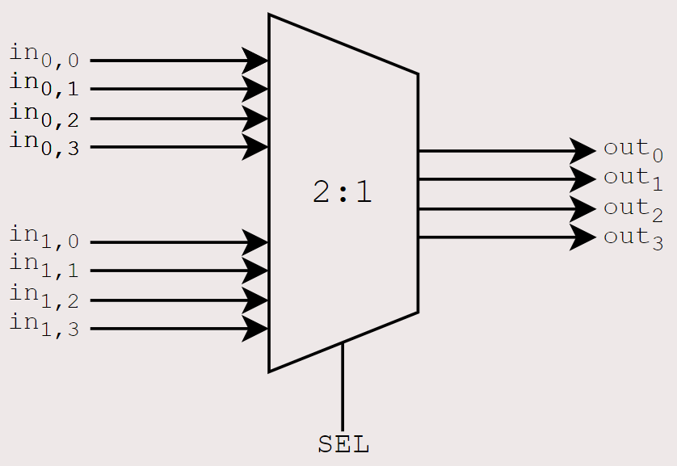
This work (6) Summary
Take a component
Extract features
Synthesize each configuration
Example for BW=4 and IN=2
Notes:
In this work we use the average toggle activity at the component’s interface. At the beginning we said that the switching activity is the amount of times a net toggles. Here we take how many times on average the input and output of a component toggle. We will lose accuracy, because the internal nets are way more that the input and output bitlines, but this is the cost for abstracting. However, the bet of this approach is that the interface activity is representative enough of the internal activity. This abstraction allows us to build a systematic way for data generation
Continuing the example of one of the 183 designs, for the sake of simplicity we take 2 input and 4 bitwidths.

Slide 28
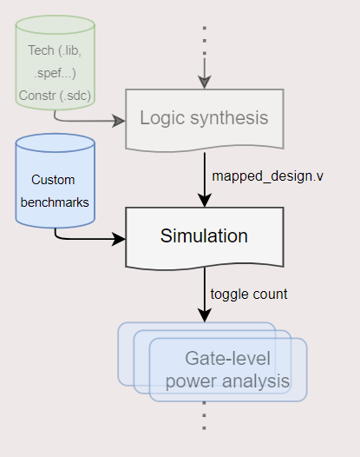
This work (6) Summary
Take a component
Extract features
Synthesize each configuration
Simulate sweeping average input toggle activity
Notes:
In this work we use the average toggle activity at the component’s interface. At the beginning we said that the switching activity is the amount of times a net toggles. Here we take how many times on average the input and output of a component toggle. We will lose accuracy, because the internal nets are way more that the input and output bitlines, but this is the cost for abstracting. However, the bet of this approach is that the interface activity is representative enough of the internal activity. This abstraction allows us to build a systematic way for data generation
Continuing the example of one of the 183 designs, for the sake of simplicity we take 2 input and 4 bitwidths.

Slide 29
This work (6) Summary
Take a component
Extract features
Synthesize each configuration
Simulate sweeping average input toggle activity
Simulate each input toggle activity multiple times with random initial states
BW = 4
TR = 25%
Benchmark generator
0000
0001
1001
0010
0000
0100
1001
1000
0000
Notes:
In this work we use the average toggle activity at the component’s interface. At the beginning we said that the switching activity is the amount of times a net toggles. Here we take how many times on average the input and output of a component toggle. We will lose accuracy, because the internal nets are way more that the input and output bitlines, but this is the cost for abstracting. However, the bet of this approach is that the interface activity is representative enough of the internal activity. This abstraction allows us to build a systematic way for data generation
Continuing the example of one of the 183 designs, for the sake of simplicity we take 2 input and 4 bitwidths.

Slide 30
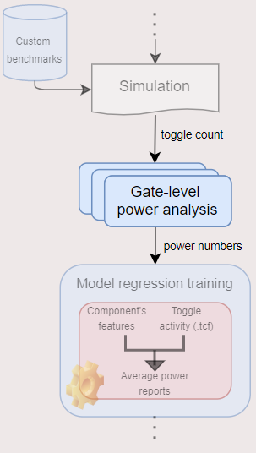
This work (6) Summary
Take a component
Extract features
Synthesize each configuration
Simulate sweeping average input toggle activity
Simulate each input toggle activity multiple times with random initial states
Compute power (Joules)
Notes:
In this work we use the average toggle activity at the component’s interface. At the beginning we said that the switching activity is the amount of times a net toggles. Here we take how many times on average the input and output of a component toggle. We will lose accuracy, because the internal nets are way more that the input and output bitlines, but this is the cost for abstracting. However, the bet of this approach is that the interface activity is representative enough of the internal activity. This abstraction allows us to build a systematic way for data generation
Continuing the example of one of the 183 designs, for the sake of simplicity we take 2 input and 4 bitwidths.

Slide 31
This work (6) Summary
Take a component
Extract features
Synthesize each configuration
Simulate sweeping average input toggle activity
Simulate each input toggle activity multiple times with random initial states
Compute power (Joules)
Build labelled dataset
Repeat for each component
Repeat for each feature’s configuration
Notes:
Now we have the labelled dataset to train ML

Slide 32
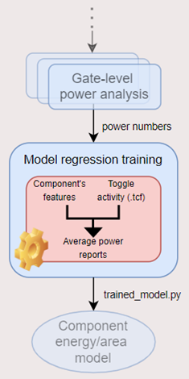
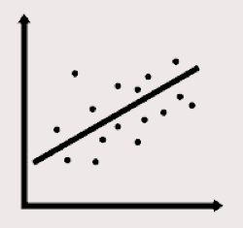
Regression-based approach (1)
Linear
Linear with mean square penalty
Linear with lasso penalty
Notes:
-The following regression algorithms are evaluated
-Linear regression with 2 different penalties: interpolation

Slide 33

Regression-based approach (1)
Linear
Linear with mean square penalty
Linear with lasso penalty
Decision tree-inspired
Decision tree (DT)
DT ensemble methods:
Random forest (bagging): independent DT
Extreme gradient (boosting): sequential DT
Notes:
-Decision trees (iteratively divide the feature space and tries to find patterns in the form of binary decisions
-2 ensemble methods derived from DT:

Slide 34
Regression-based approach (1)
Linear
Linear with mean square penalty
Linear with lasso penalty
Decision tree-inspired
Decision tree (DT)
DT ensemble methods:
Random forest (bagging): independent features DT
Extreme gradient (boosting): sequential DT
.
.
.
.
.
.
Support vector regression (SVR)
Notes:
SVR: it works by finding the hyperplane (in this case line) that best separate the data

Slide 35
Regression-based approach (2)
Components characterization of: multiplexer, adder and multiplier
Notes:
-once we have the labelled data
-we can evaluate the ML algorithms

Slide 36
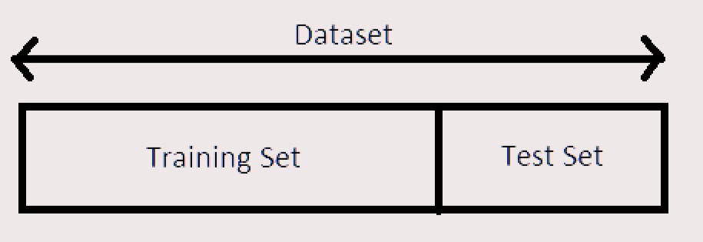
Regression-based approach (2)
Components characterization of: multiplexer, adder and multiplier
Split dataset into training and testing

Slide 37
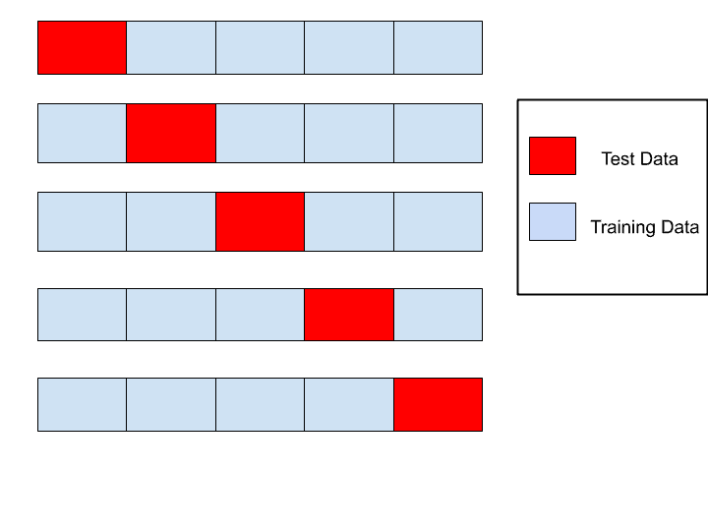
Regression-based approach (2)
Components characterization of: multiplexer, adder and multiplier
Split dataset into training and testing
Cross-validation check to prevent overfitting

Slide 38
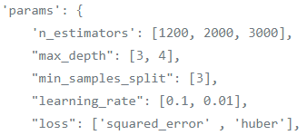
Regression-based approach (2)
Components characterization of: multiplexer, adder and multiplier
Split dataset into training and testing
Cross-validation check to prevent overfitting
Grid-search for best hyperparameter tuning

Slide 39
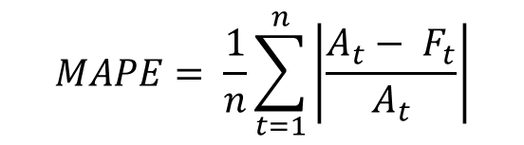

Regression-based approach (2)
Components characterization of: multiplexer, adder and multiplier
Split dataset into training and testing
Cross-validation check to prevent overfitting
Grid-search for best hyperparameter tuning
Regressor with best mean absolute percentage error (MAPE) is chosen
$$MAPE= \frac{1}{n}\sum_{t=1}^{n}{\left|\frac{A_{t}− F_{t}}{A_{t}}\right|}$$
Where:
$A_{t}$ actual value
$F_{t}$ forecasted value

Slide 40
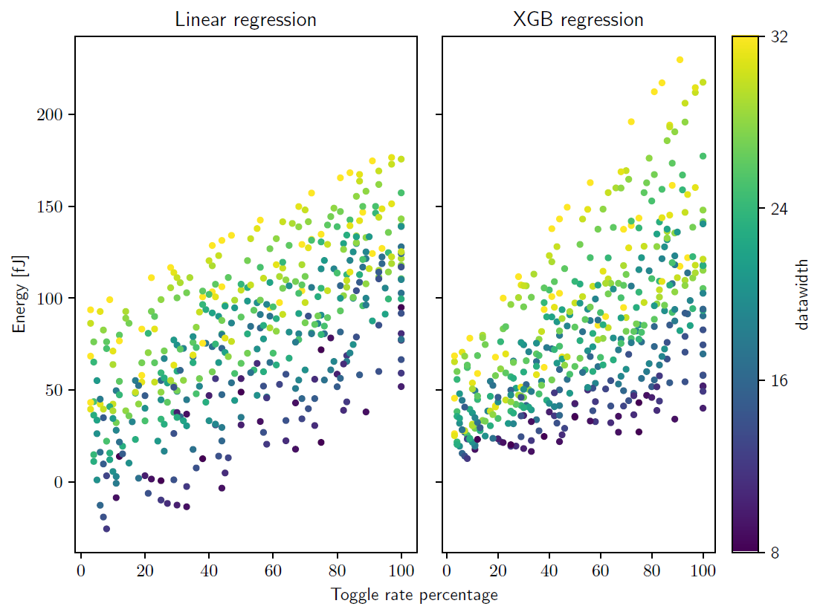
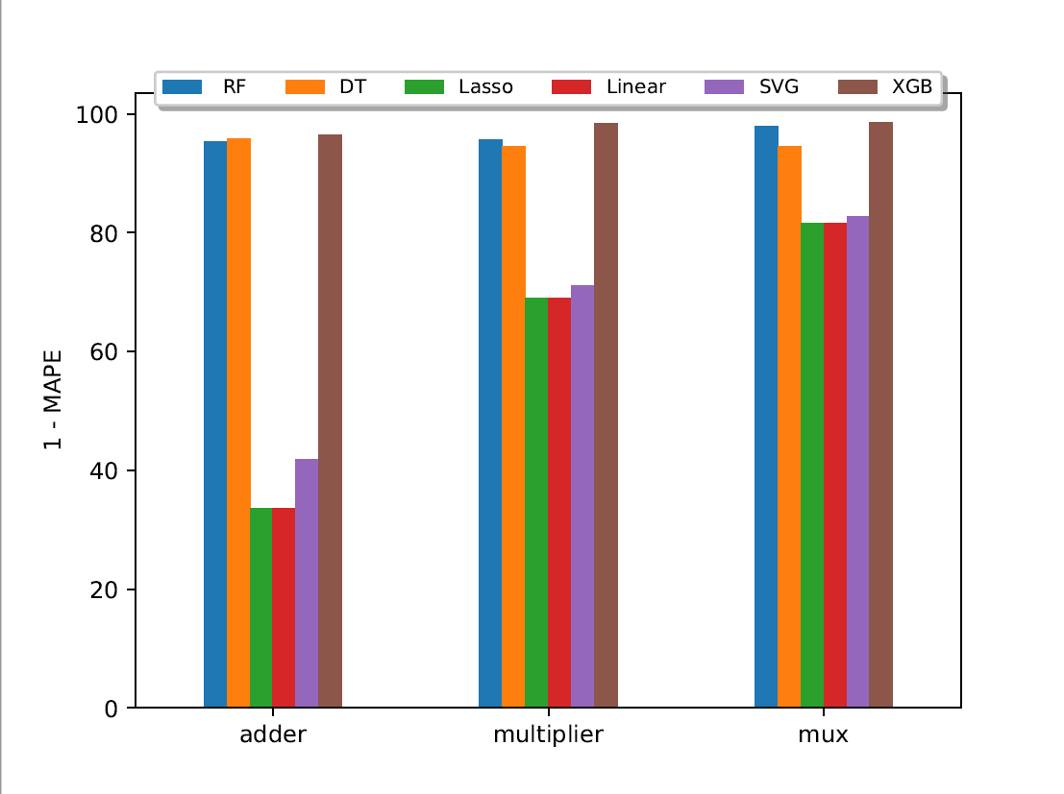
Regression-based approach (3)
Purpose of a model is not to fit the data, but to sharpen the question (S. Karlin)
Notes:
-On the left…
-On the right…
-Now we have chosen the algorithm, so we can apply the approach to a use case

Slide 41
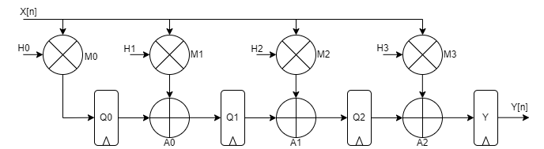
Experimental validation: FIR filter
Transposed FIR fitler components’ decomposition
(M_{i} = multipliers; A_{i} = adders; Q_{i} ,Y = registers)
Characterization phase:
Average input/output toggle rate (1%-100%)
Bitwidth (8bit -32bit)
XGB supervised learning
Notes:
-For a use case, we take a FIR filter which
-Here we have the structural decomposition, where we see 4 multipliers, …
-We characterize a multiplier, an adder a register
-We use xgb

Slide 42
Experimental validation: FIR filter
Transposed FIR fitler components’ decomposition
(M_{i} = multipliers; A_{i} = adders; Q_{i} ,Y = registers)
Run-phase:
Run arbitrary workload (RTL)
Parse activity and features
Instant power inference from activity
Do we achieve post-synthesis accuracy?
Notes:
For the run phase, we simulate the workload, parse the activity at the interface of each component, and infer the power given the features. Then we compare it with the measure performed with industry tools.

Slide 43
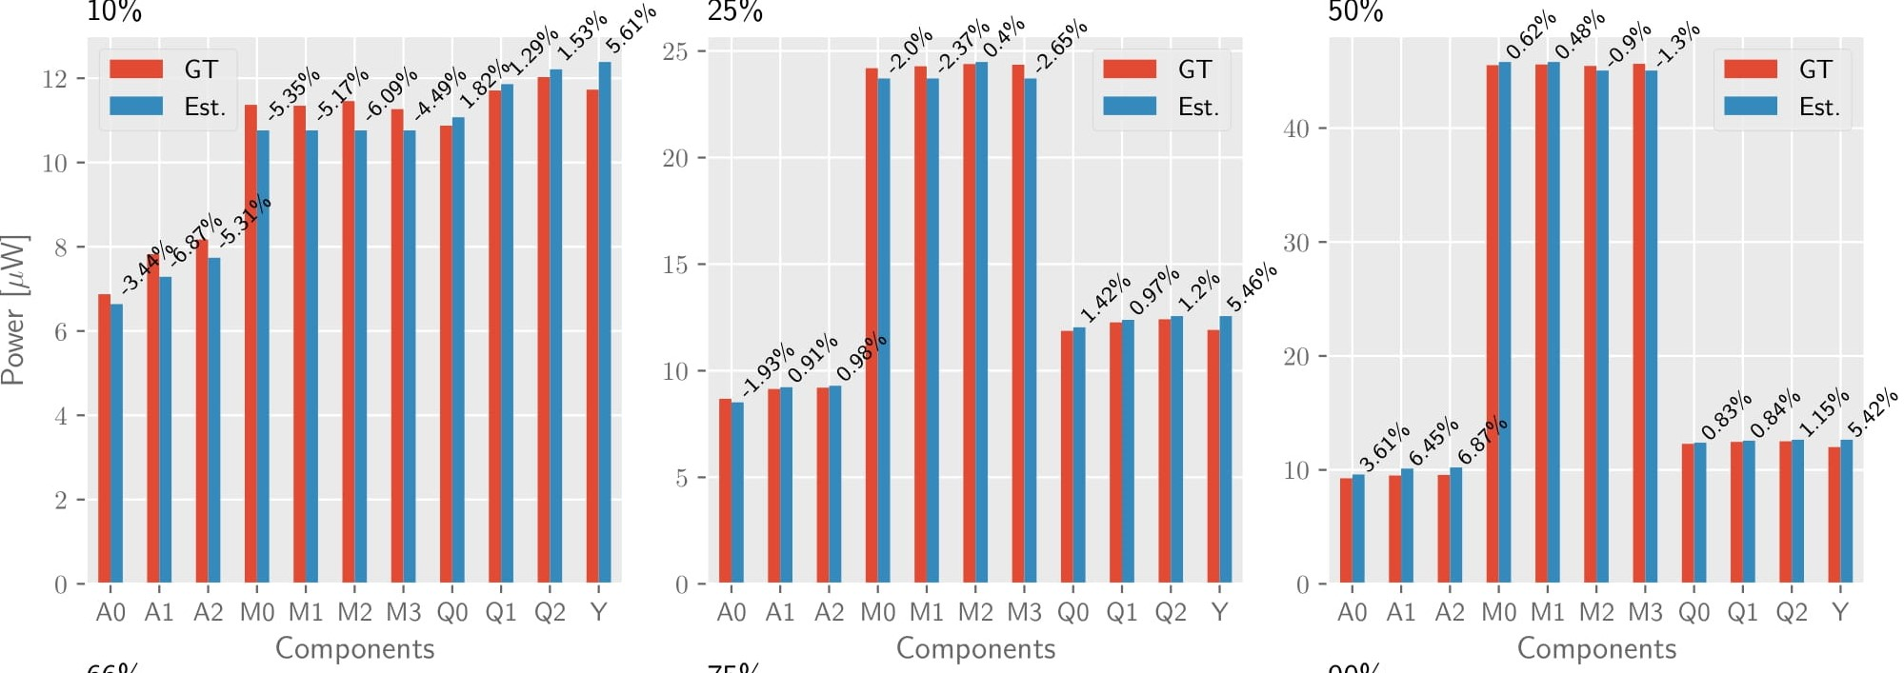
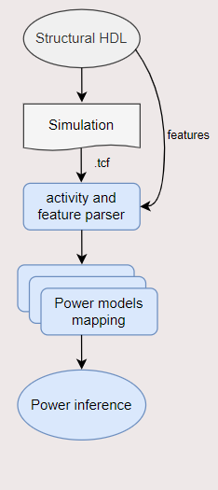
Experimental validation: FIR filter Results
Feed the
Notes:
-Here we have the results for every component for the 8bit case for 3 different input activities.
-On the x axis, we have the components
-In red the reference number, in blue the estimation
-We see that the estimation follows the trend.
-For low activity, A and M underestimate, then higher
-Also multiplier increases more than the others but the model follows
-Register offset

Slide 44
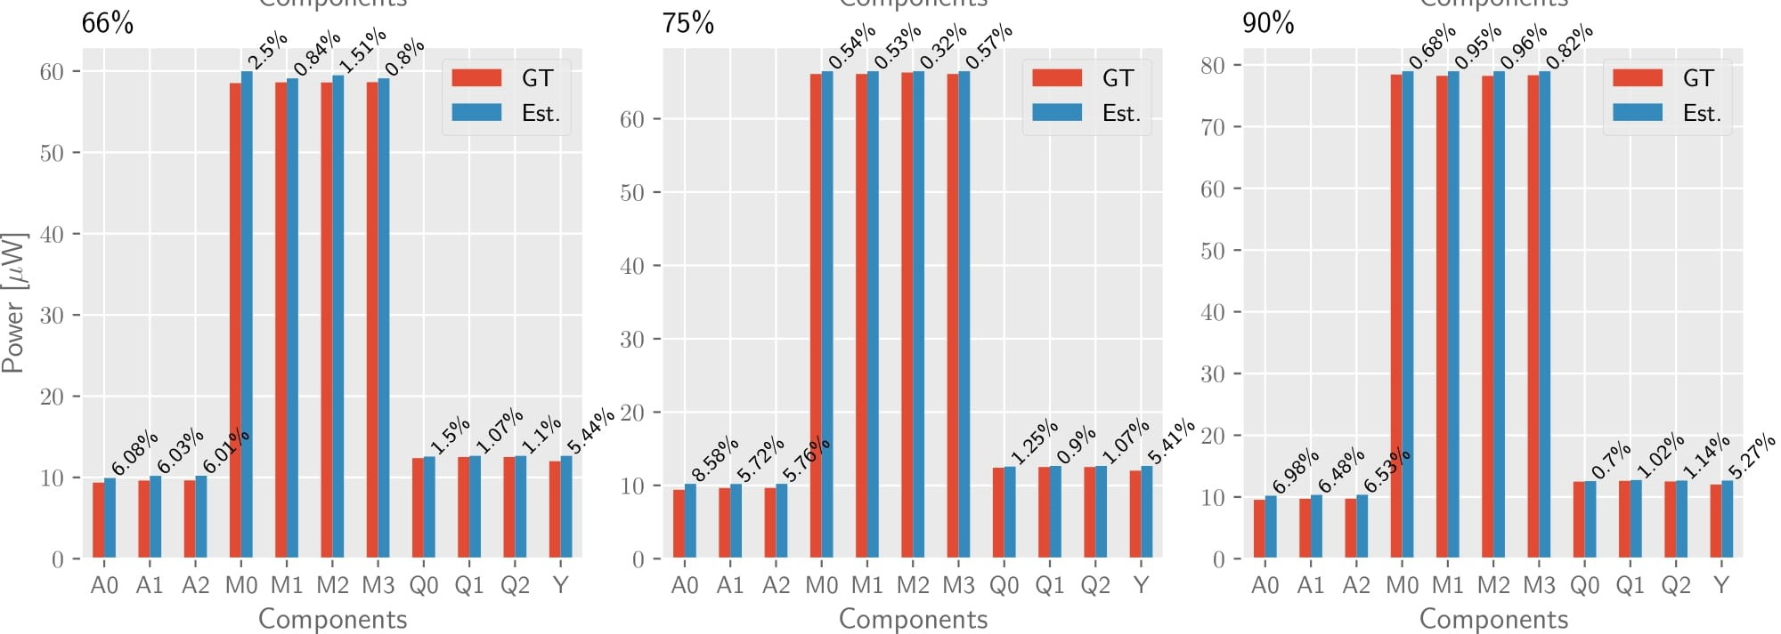
Experimental validation: FIR filter Results
Feed the
Notes:
-For higher activities, we see the same trend, with multiplier the highest
-Now we lump all the components together in a single bar

Slide 45
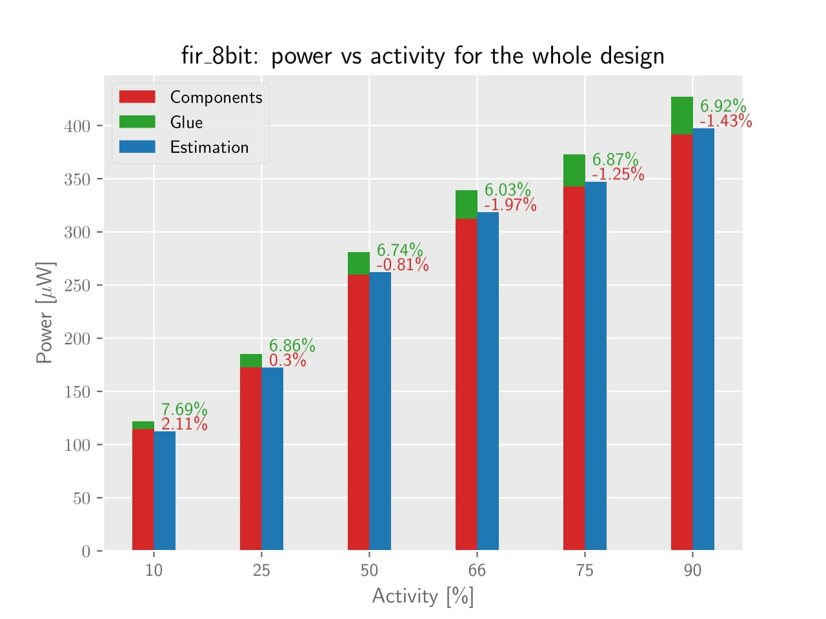
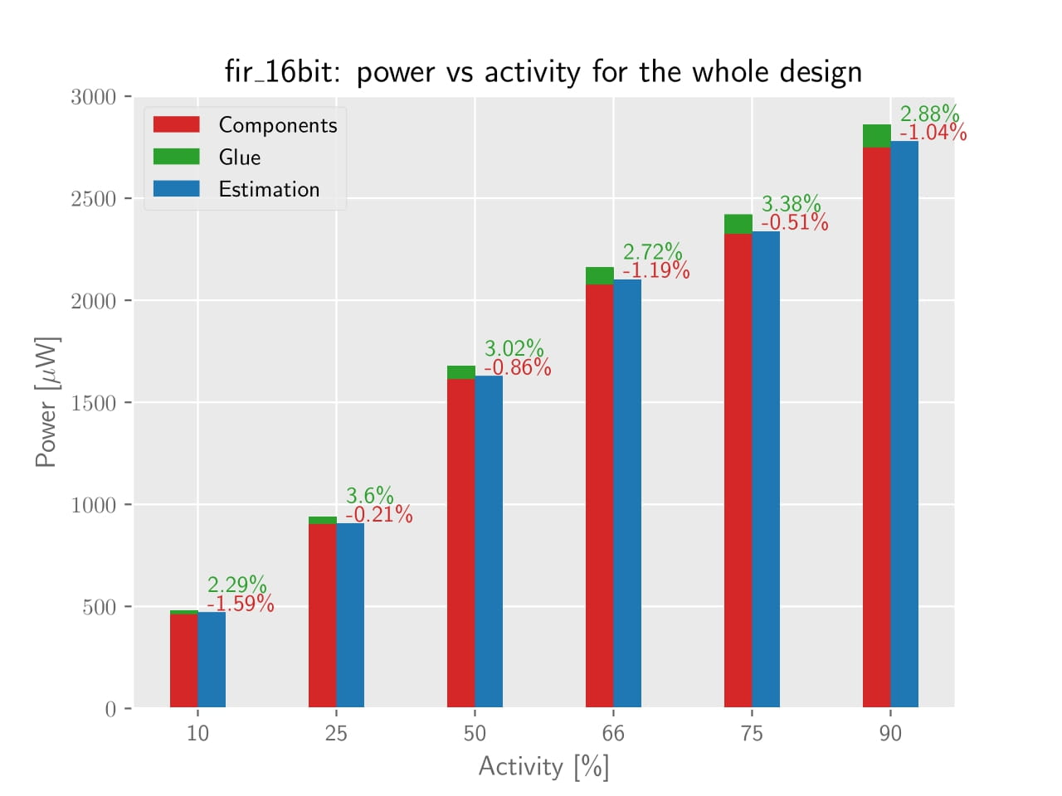
Experimental validation: FIR filter Results
Notes:
-Sum the contribution of each component for different toggle rates to have a higher view of the design
-Again red components, Blue estimation And in green now we have the glue logic
-Glue logic is logic inferred in-between components when we synthesizing the whole design to ensure to meet physical requirements
-Analyzing the error in red (only the components) we see that it is much smaller than the previous
-Analyzing the error in green -> offset

Slide 46

Experimental validation: FIR filter Limitations
Glue logic: it is inferred during synthesis of the final design
the whole is greater than the sum of each (attributed to Aristotle)
Output activity: it takes part to the power consumption
…no way to exhaustively sweep output toggle activity
Control logic: it needs cycle-accurate information
384–322 BC
Notes:
-Glue logic: total power is not only the sum of the components but also something in between, hence the quote can be applied to many fields, and from today also in digital electronics
-we deal only with stream processing applications

Slide 47
Future work to improve the results
Weighted contribution: every bitline affacts power differently
Glitching: no all toggles are back-annotated
Hierarchy: how much is the power affected adding more hierarchies?

Slide 48

Conclusion
Analytical approach:
Regression approach:
Limitations:
Stream processing applications
Structural design
Only one case studied
Manual feature extraction
+Fast
+Hierarchical
-Actions
-Analytical
+accurate
+real data traces
-Long trainings
-Fixed to hardware
short!
generic!
Github repo: https://github.com/damonti/Characterization
Notes:
So to wrap up: we can see if what we did in comparison with other works the things we addressed. We did so by proposing a new approach that however added some limitations

Slide 49
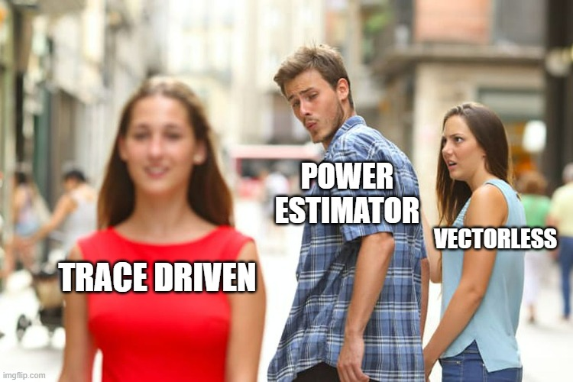
Questions?
Thank you!
Switching activity
Notes:
Presentation in over. Thank you for your attention and bearing with me. I am open for questions.

